Slide 1
Adaptive Minds: Enhancing Domain Versatility of LLMs through Parameter-Efficient Fine-Tuning
19 August 2024, Master Thesis Kick-off
Mehul Raj Kumawat
Notes:
Good Afternoon Everyone. Welcome to the kick-off presentation of the Enhancing Domain Versatility of LLMs Through PEFT
------
Does DA of LLMs summarizes LR domains
--------
Rework the idea, ->
focus on 2 different questions
1. Teaching model new knowledge - from PEFT
best techniques that teaches model the best
2. how well the model will perform on Low Resource DA?
models sees 5 domains, 6th new domain, model leverages 5 DA knowledge and performs better on 6th one
[Zero shot -> ]
initial exps -> for knowing which techniques are better or best ones.

Slide 2
Outline
Introduction & Motivation
Research Questions
Baseline
Methodology
PoC
Timeline

Slide 3

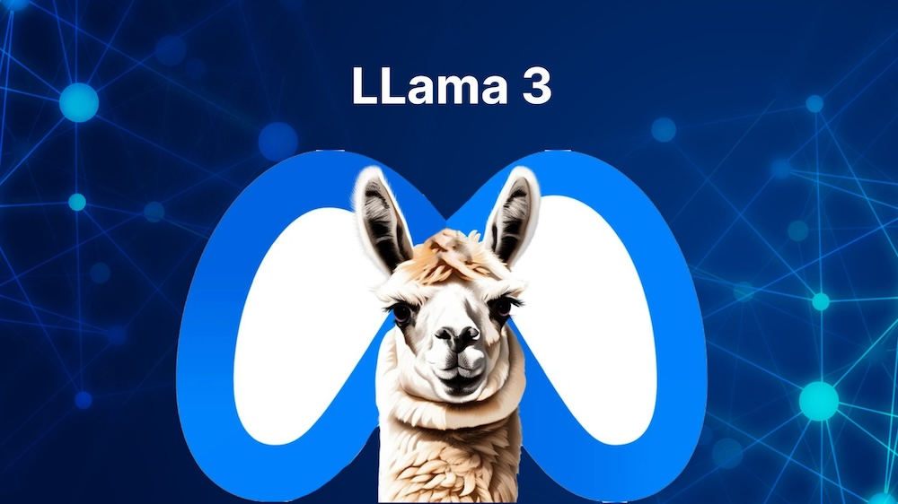

Introduction: LLMs
Popularity of LLMs
Great at solving generic tasks
Growth of large corpus and hardware capacities
Many applications
Achieved remarkable results.
https://openai.com/index/gpt-4/
https://llama.meta.com/llama3/
https://mistral.ai/
Notes:
The popularity of LLMs have increased in recent times as they are easily accessible and they are great at solving generic natural language processing tasks. Their rise is credited to the growth of large corpus for training and with the availability of a lot and powerful hardware resources. These models have many applications like Retreival Augmented Generation, Translation, virtual assistants, etc., achieving remarkable results.
Some LLMs used widely are GPT-4, Llama, Mistral
Add:
DA techniques used in these models,
Show evolution of DA rather than NLP.
Many applications - RAGs, Translation, Assistants, Summarization
E.g.: GPT4, LLaMA, Mistral
Large language models, or LLMs, have revolutionized natural language processing by achieving remarkable results across various tasks
instruction tuned LLMs: follow instruction when prompted by the user

Slide 4
Introduction: Challenges
Challenge 1
Larger models perform better than the smaller models on tasks – 70B model vs 7B model
Challenge 2
LLMs have limited coverage in terms of various domains
Challenge 3
Struggle with specialized knowledge of domains
Challenge 4
Intensive modelling and computational complexity
Ling, C., Zhao, X., Lu, J., Deng, C., Zheng, C., Wang, J., Chowdhury, T., Li, Y., Cui, H., Zhang, X.,
Zhao, T., Panalkar, A., Mehta, D., Pasquali, S., Cheng, W., Wang, H., Liu, Y., Chen, Z., Chen, H., . . .
Zhao, L. (2023). Domain Specialization as the Key to Make Large Language Models Disruptive:
A Comprehensive Survey. ArXiv. /abs/2305.18703
Notes:
They do come with Challenges,
Larger models perform better than the smaller models on tasks – 70B model vs 7B model
The larger models have out performed smaller ones in many tasks, and given better performance
LLms Have limited coverage in terms of variety of domains.
Their training data do not cover all the domains existing in the world, some are low resources, some are high but not included in training corpus.
Struggle with specialized knowledge of different domains
Like mentioned previously , LLMs are great at solving generic tasks, but when we talk about going into depth, they are not very good, and may hallucinate.
intensive modelling and computational complexity required for downstream task learning
End-2-end training requires high computational resources even for a small task.

Slide 5
Introduction: Domain Adaptation
Domain Adaptation
Domain shift
General-purpose models are impossible one-fits-all solvers
Special case of transfer learning
Requirement of in-depth knowledge
Notes:
Domain adaptation is a special case of transfer learning that only covers the change of the data domain.
the source and target domains all have the same feature space (but different distributions).
in contrast, transfer learning includes cases where the target domain's feature space is different from the source feature space or spaces.
Why do we need DA?
Since general purpose models are impossible one-fits-all solvers, domain adaptation allows us to be more specific to domains for particular tasks, where we require in-depth knowledge for better understanding of concepts.
Since, DA is applied where the source and target domains are from different distributions. Implying it helps in tackle domain shift.
It also allows to cover languages style where differences are significant.
___________________________________________________________________________________________________________
Domain Shift-> is a change in the data distribution between an algorithm's training dataset, and a dataset it encounters when deployed.
apply an algorithm trained in one or more source domains to a different target domain
the source and target domains all have the same feature space (but different distributions)
in contrast, transfer learning includes cases where the target domain's feature space is different from the source feature space or spaces.
- Domain shift
- General-purpose models are impossible one-fits-all solver
- Requirement of in-depth knowledge
- Significant differences in language styles

Slide 6
Introduction: Adapting Domains
Fine-tuning Methods:
Traditional fine-tuning (with and without freezing)
Parameter-efficient Fine-tuning (PEFT)
LM Prompting:
Zero-Shot Learning
In-Context Learning (Baseline)
Human Preferences Tuning
Prompt Tuning
Notes:
To adapt domains, to perform various downstream tasks, like commonsense reasoning, multiple-choice question answering, story generation, summarization
We can utilize different methods like
Fine-tuning methods are:
Traditional FT, - training all wts, when we freeze wts, we train the wts of last layers.
PEFT: -–
Prompt Tuning: Prompt tuning method attach and learn embeddings to the input;
Learn embeddings for placeholder tokens in the pattern.
Initialize using a vocabulary embedding
LM Prompting (since LLMs are instruct tuned, we can give prompts to perform tasks. )
Zero Shot Learning – only an instruction or prompt
In-context Learning – instruction with a few examples.
Human Preferences Tuning – uses Reinforcement Learning with Human interactions - not included in the scope of the project.
___________________________________________________________________________________________________________________
for enc-dec
Decoder architecture ->
LMs FT using enc-dec model,
**Careful with terminologies.
Focusing on Domain Adaptation ----- understanding different domains/ data it hasn't
chatbots - XXXX
Pose the idea - LMs struggle with adapting to understanding new vocabl
small models struggle with zero shot learning.
motivation to work on smaller language model, make them perform better from in-context learning.
Domain shift
adaptation on specific needs or domains.

Slide 7
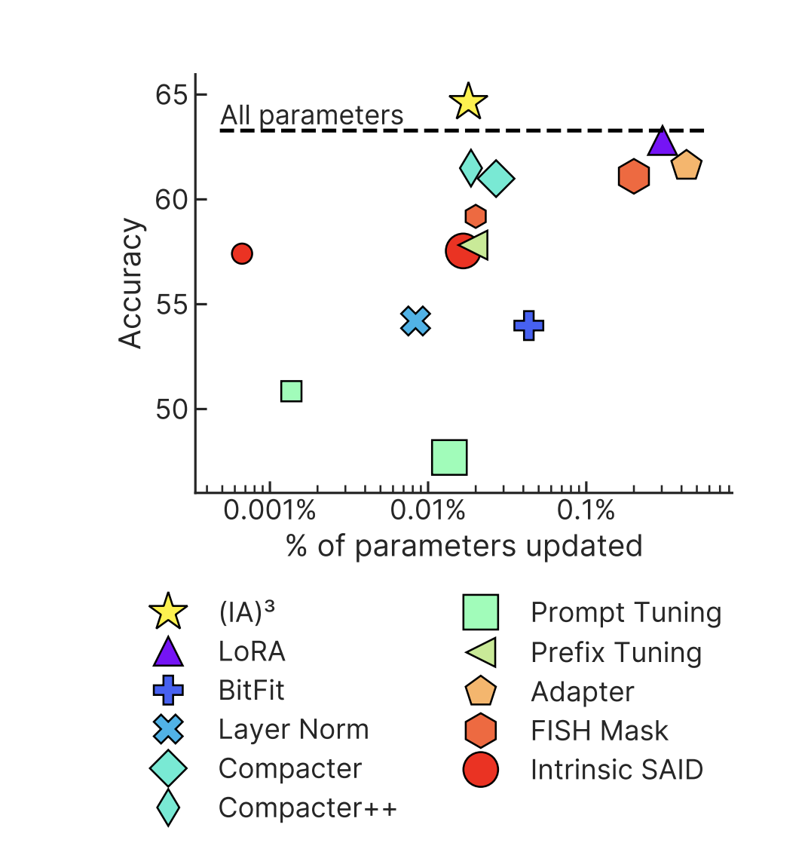
Introduction: PEFTs
Parameter-efficient Fine-tuning (PEFT) Techniques
BitFit
Adapters
Representation
Fine-tuning
LoRA
(IA)³
Liu, H., Tam, D., Muqeeth, M., Mohta, J., Huang, T., Bansal, M., & Raffel, C. (2022). Few-Shot Parameter-Efficient
Fine-Tuning is Better and Cheaper than In-Context Learning. ArXiv. /abs/2205.05638
Notes:
These methods involve fine-tuning only a subset of the model's parameters or adding new parameters that can be fine-tuned separately, making the process more computationally efficient.
The graph shows the accuracy vs % age of parameters updated on the RAFT benchmark {RAFT: A Real-World Few-Shot Text Classification Benchmark} [model – T0], showing IA3 is the best performing one.
Here we see the % of model parameters trained are < 1%.
(IA)^3 => Infused Adapter by Inhibiting and Amplifying Inner Activations

Slide 8
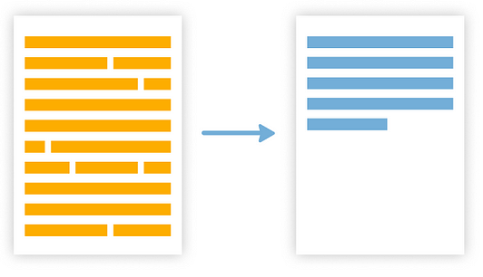
Motivation
Low generalization ability on unseen Domains
Gap exists between the low-resource and high-resource settings
Summarization
Small LLMs struggle in understanding new vocabulary
Cover multiple domains so that low-resource domains are covered
https://medium.com/@abstractive-health/extractive-vs-abstractive-summarization-in-healthcare-bfe7424eb586
Yu, T., Liu, Z., & Fung, P. (2021). AdaptSum: Towards Low-Resource
Domain Adaptation for Abstractive Summarization. ArXiv. /abs/2103.11332
Notes:
LLMs are great generic task solvers, but they have low ability to generalize on many domains,
Hence, there is a gap that exists between low and high resource settings.
Implying smaller LLMs perform poorly on low resource domain specific tasks, as they struggle with understanding new vocabulary, and Zero-shot learning doesn’t give good performances with respect to the limited knowledge the LLM has.
Hence, we want to cover multiple high resource domains while fine-tuning an LLM so that it is able to cover the feature space of low resources domain.
In this project we work with the Task of Summarization.

Slide 9
Outline
Introduction & Motivation
Research Questions
Baseline
Methodology
PoC
Timeline

Slide 10
Research Questions
Research Question 1
Can a smaller Large Language Model (LLM) adapt well to an unseen domain using a parameter-efficient fine-tuning method and perform effectively on the task of summarization?
Research Question 2
Can we leverage multiple parameter-efficient fine-tuning techniques to enable an LLM to simultaneously learn and perform well across various domains?
Research Question 3
Are there parameter-efficient fine-tuning techniques that enable an LLM to adapt well to a specific domain, or do they perform effectively across multiple domains for an LLM?
Research Question 4
After training an LLM on multiple high-resource domains, can it achieve strong performance on an unseen low-resource domain?
Notes:
Q1. Can a smaller Large Language Model (LLM) adapt well to an unseen domain using a parameter-efficient fine-tuning method and perform effectively on the task of summarization?
for our PoCwe adapted Medical and Scientific domain and we were able to generate some results with a few epochs, we trained our model on 500 samples.
Q2. Can we leverage multiple parameter-efficient fine-tuning techniques to enable an LLM to simultaneously learn and perform well across various domains?
In our PoC we adapted Medical and Scientific domain, we simulatenously tried training 2 different techniques – LoRA and IA3 with Pubmed and Arxiv Respectively..
Q3. Are there parameter-efficient fine-tuning techniques that enable an LLM to adapt well to a specific domain, or do they perform effectively across multiple domains for an LLM?
is one domain easily adaptable than another, if so why is it so?
Q4. After training an LLM on multiple high-resource domains, can it achieve strong performance on an unseen low-resource domain?

Slide 11
Outline
Introduction & Motivation
Research Questions
Baseline
Methodology
PoC
Timeline

Slide 12
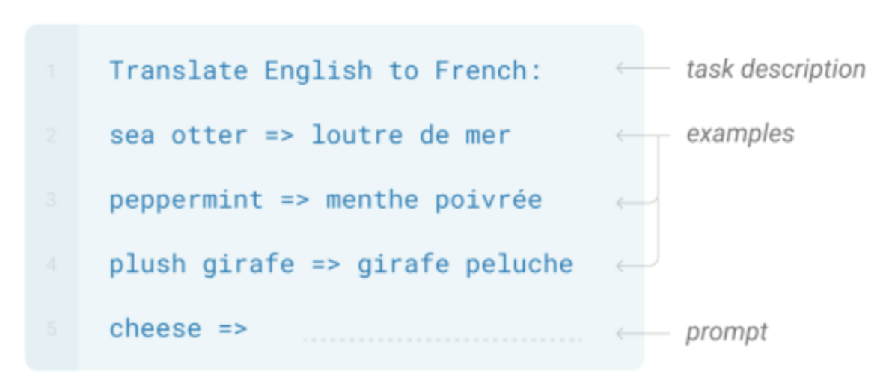
Baseline: Two-shot Learning
Continuation of AdaptEval
Compare fine-tuning and in-context learning settings
Baseline: In-context learning (Two-shot Learning)
 | Medical |  |  | Science
 | BERTScore | DVO | ROUGE | BERTScore | DVO | ROUGE
ChatGPT | 0.841 | 38.58 | 22.92 | 0.837 | 38.39 | 23.15
Llama2 7b | 0.819 | 35.95 | 21.11 | 0.824 | 35.34 | 20.92
Llama2 70b | 0.845 | 37.61 | 22.40 | 0.842 | 36.65 | 23.03
Mistral 7b | 0.816 | 32.05 | 21.30 | 0.802 | 23.61 | 17.76
Table 1: BERTScore F1, DVO (%), and the geometric mean of ROUGE-1/2/L (ROUGE) of models on the Medical and Science dataset.
Afzal, A., Chalumattu, R., Matthes, F., & Espuny, L. M. (2024). AdaptEval: Evaluating
Large Language Models on Domain Adaptation for Text Summarization. ArXiv. /abs/2407.11591
Brown, T. B., Mann, B., Ryder, N., Subbiah, M., Kaplan, J., Dhariwal, P., Neelakantan, A., Shyam, P., Sastry, G.,
Askell, A., Agarwal, S., Krueger, G., Henighan, T., Child, R., Ramesh, A., Ziegler, D. M., Wu, J., Winter, C., Hesse, C., . . . Amodei, D. (2020). Language Models are Few-Shot Learners. ArXiv. /abs/2005.14165
Notes:
This work is the continuation of the paper AdaptEval, in which there were many models, compared with each other on vanilla Finetuning and In-context learning settings on Medical, Science and Governement Report dataset. For our work we use medical and science data, as we will see ahead, and we do not include Gov Reports because of the huge summary lengths (10k range).
The baseline are the results from the in-context learning setting, where we see that LLaMa2 has best BERTScore on both datasets, and CHATGPT has best metrics in DVO and GM of ROUGE scores.
And hence, through this work we would want to investigate what combination is best for enhancing domain knowledge in LLMs with PEFT methods.
DVO -> Domain Vocabulary Overlap (DVO)

Slide 13
Outline
Introduction & Motivation
Research Questions
Baseline
Methodology
Timeline

Slide 14
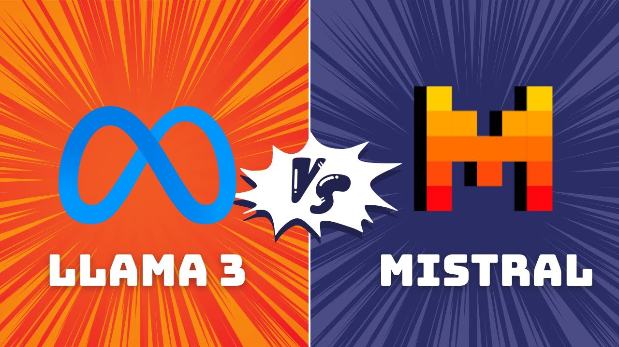


Methodology
Domains
Medical Records
Legal Documents
Government Reports
News
Articles
Religious Texts
Scientific Texts
E-commerce Reviews
Evaluation
Analysis
https://techovedas.com/bigger-vs-better-can-llama-3-size-overpower-mistral-7b-accuracy/
https://docs.adapterhub.ml/
Notes:
We select out dataset

Slide 15
Methodology - Dataset
Domains
Medical Records
Legal Documents
Government Reports
News
Articles
Religious Texts
Scientific Texts
E-commerce Reviews
PubMed Summarization
Multi-
LexSum
News
Summarization
Arxiv Summarization
Len(Article):
5000-10000
Len(Summary):
150-300
Len(Article):
3000-10000
Len(Summary):
150-300
Len(Article):
7000-10000
Len(Summary):
100-500
Len(Article):
500-1500
Len(Summary):
50-150
Arxiv: https://huggingface.co/datasets/ccdv/arxiv-summarization
Multi-lex sum: https://huggingface.co/datasets/allenai/multi_lexsum
Pubmed: https://huggingface.co/datasets/ccdv/pubmed-summarization
News summarization: https://www.kaggle.com/datasets/sbhatti/news-summarization/data
Notes:
There are multiple domains available,
Scientific Texts
Religious Texts
Medical Records
Government Reports
Legal Documents
E-commerce Reviews
News Articles
Highlight the ones selected
Average length of the articles, average length summary.

Slide 16
Methodology: LLM
8 billion parameters
More versatile
Supports 128,256 tokens (up from 32,000 in LLaMA 2)
7 billion parameters
Outperforms Llama 2 (13B) on all benchmarks
Manages up to 128K tokens with reduced computational cost
https://llama.meta.com/llama3/
https://mistral.ai/
Notes:
For our work we choose between LLaMA3 or Mistral, after performing a PoC.
LLaMa3 is latest model released by Meta, with 8 B params, provides advanced reasoning and content generation across formats, making it more versatile. It supports 128K tokens.
Mistral on the other hand has 7 B params, and it was outperforming LLaMA2 – 13B on all benchmarks, as it can take 128K tokens with reduced computational costs.

Slide 17
Methodology: LLM
Supports more PEFTs
Latest
Better results in PoC
Fusion Compatible
https://llama.meta.com/llama3/
https://mistral.ai/
Notes:
For our work we choose between LLaMA3 or Mistral, after performing a PoC.
LLaMa3 is latest model released by Meta, with 8 B params, provides advanced reasoning and content generation across formats, making it more versatile. It supports 128K tokens.
Mistral on the other hand has 7 B params, and it was outperforming LLaMA2 – 13B on all benchmarks, as it can take 128K tokens with reduced computational costs.

Slide 18
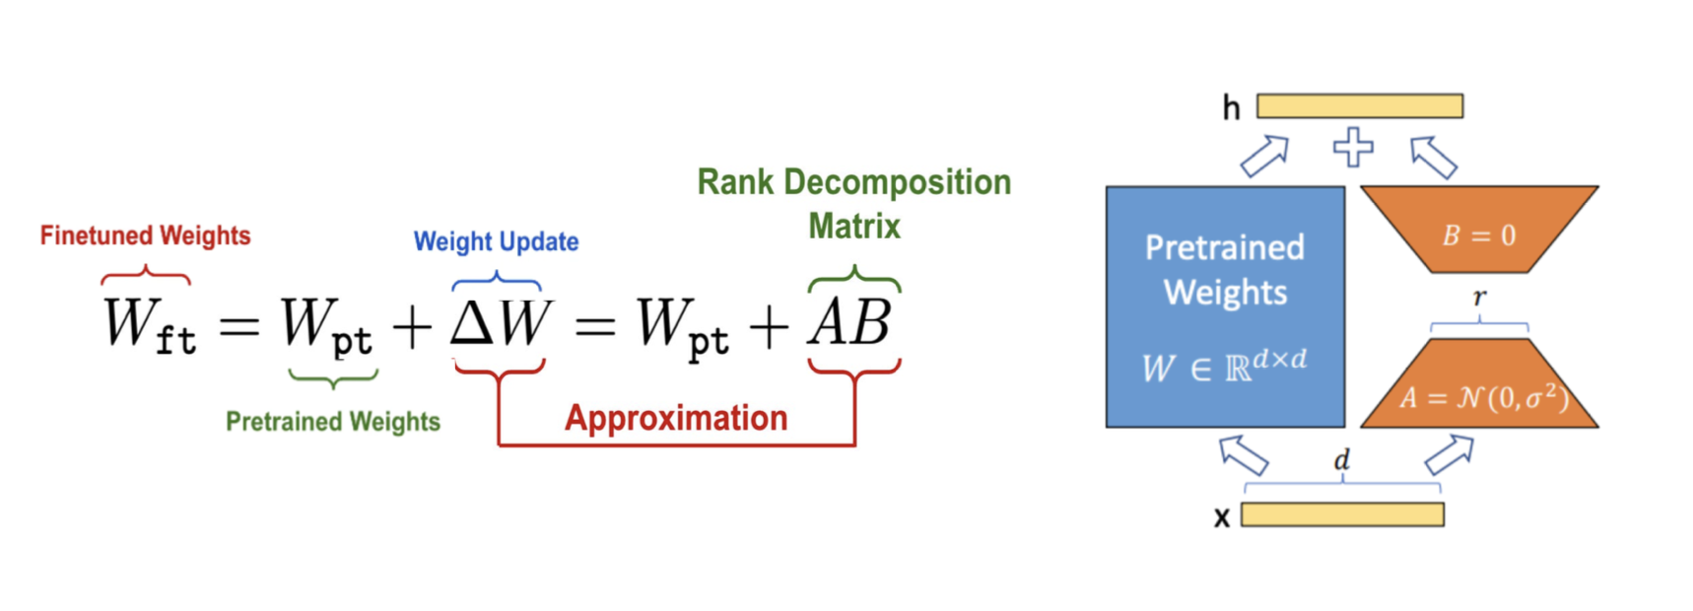
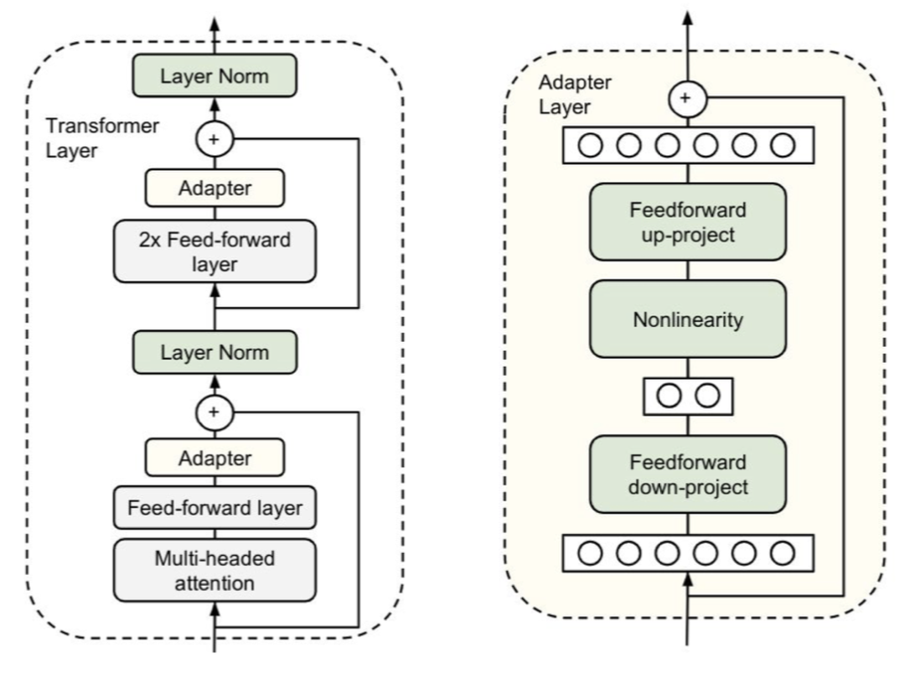
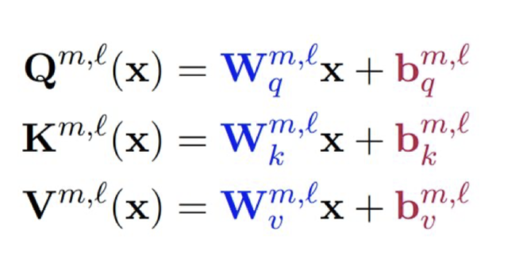
Methodology: PEFT
BitFit
Adapters
LoRA
Hu, E. J., Shen, Y., Wallis, P., Li, Y., Wang, S., Wang, L., & Chen, W. (2021). LoRA: Low-Rank Adaptation of Large Language Models. ArXiv. /abs/2106.09685
Zaken, E. B., Ravfogel, S., & Goldberg, Y. (2021). BitFit: Simple Parameter-efficient Fine-tuning for Transformer-based Masked Language-models. ArXiv. /abs/2106.10199
Houlsby, N., Giurgiu, A., Jastrzebski, S., Morrone, B., De Laroussilhe, Q., Gesmundo, A., Attariyan, M., & Gelly, S. (2019). Parameter-Efficient Transfer Learning for NLP. ArXiv. /abs/1902.00751
Notes:
After selecting a model we will add different PEFT Techniques. We have multiple technologies available as seen earlier.
Parameter Efficient Fine Tuning Technologies
BitFit
BitFit fine-tunes only the bias terms in the model's layers.
Success in tasks like text classification, sentiment analysis
Adapters
Small neural network modules added to each layer of a PLM.
Minimal additional parameters, retaining most of the original model
Modular - easily added or removed
LoRA
Introduces low-rank matrices into the layers
low-rank matrices are trained during the fine-tuning process
Representation
Fine-tuning
Modifies only the representation layers or specific parts
Focus on adapting the representations learned by PLM
AdapterFusion
Combines multiple adapters
Multiple task-specific adapters within the same model
Compatible with existing transformer-based architecture

Slide 19
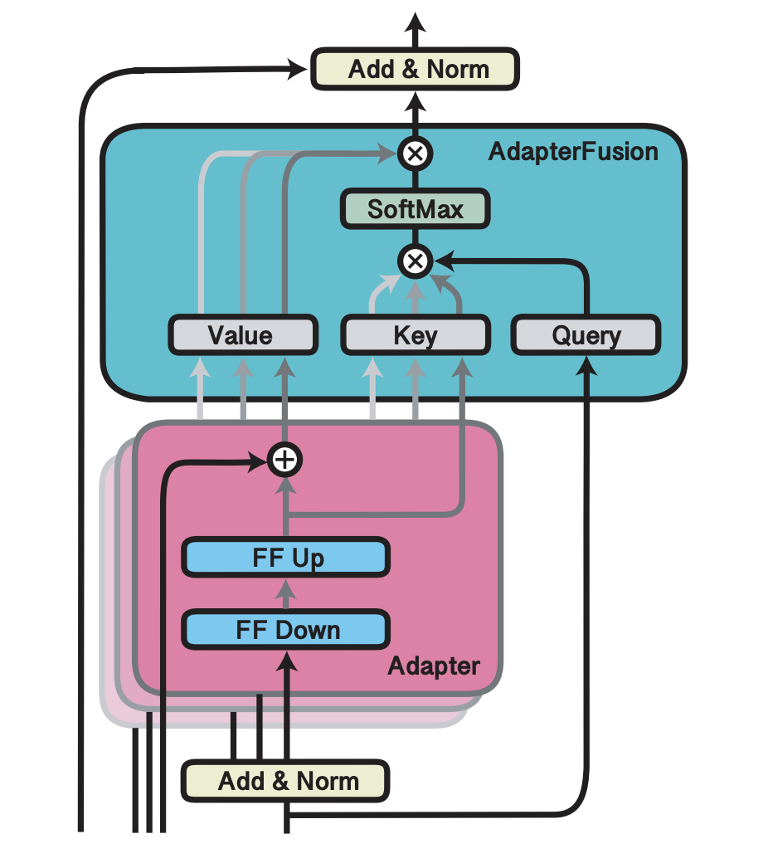
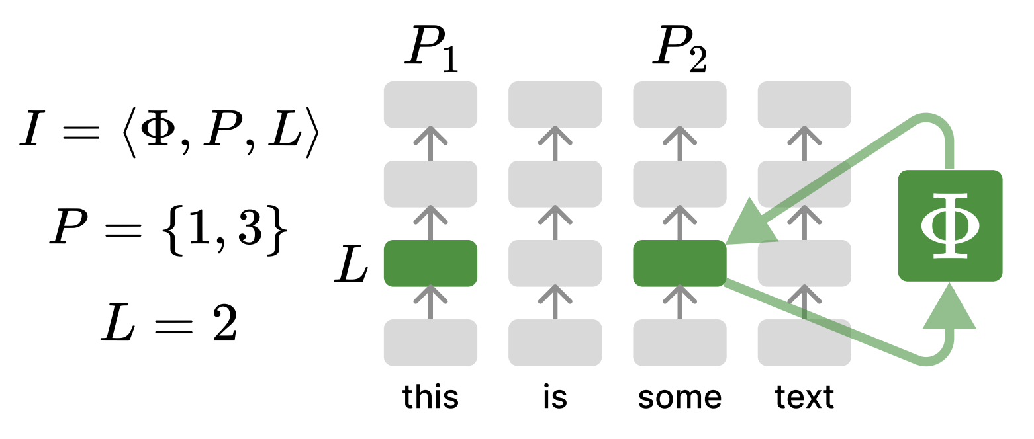
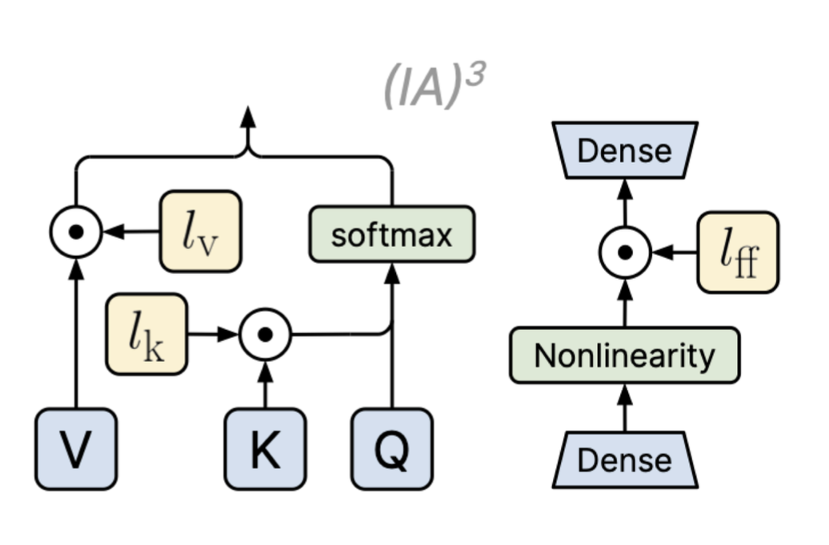
Methodology: PEFT
Representation Fine Tuning
(IA)³
AdapterFusion
Pfeiffer, J., Kamath, A., Rücklé, A., Cho, K., & Gurevych, I. (2020). AdapterFusion: Non-Destructive Task Composition for Transfer Learning. ArXiv. /abs/2005.00247
Wu, Z., Arora, A., Wang, Z., Geiger, A., Jurafsky, D., Manning, C. D., & Potts, C. (2024). ReFT: Representation Finetuning for Language Models. ArXiv. /abs/2404.03592
Liu, H., Tam, D., Muqeeth, M., Mohta, J., Huang, T., Bansal, M., & Raffel, C. (2022). Few-Shot Parameter-Efficient Fine-Tuning is Better and Cheaper than In-Context Learning. ArXiv. /abs/2205.05638
Notes:
Representation Fine-tuning
Modifies only the representation layers or specific parts
Focus on adapting the representations learned by PLM
IA3 (Infused Adapter by Inhibiting and Amplifying Inner Activations ):
Element-wise rescaling of model activations with a learned vector
keys and values in self-attention
Keys and values in encoder-decoder attention Intermediate activation of the position-wise feed-forward network
can associate each task with its own learned task vector
AdapterFusion
Combines multiple Pefts
Multiple task-specific adapters within the same model
Compatible with existing transformer-based architecture

Slide 20
Methodology: Evaluation Metrics
ROUGE
Measures the overlap of n-grams
ROUGE-L: Measures the longest common subsequence
BLEU
Measures the precision of n-grams
BERTScore
LLMs as Evaluator
Evaluates similarity of BERT embeddings
Human Evaluation
Using GPT-4 for consistent evaluations across different summaries
Using humans for evaluating summaries
https://en.wikipedia.org/wiki/BLEU
https://en.wikipedia.org/wiki/ROUGE_(metric)
Zhang, T., Kishore, V., Wu, F., Weinberger, K. Q., & Artzi, Y. (2019). BERTScore: Evaluating Text Generation with BERT. ArXiv. /abs/1904.09675
Chern, S., Chern, E., Neubig, G., & Liu, P. (2024). Can Large Language Models be Trusted for Evaluation? Scalable Meta-Evaluation of LLMs as Evaluators via Agent Debate. ArXiv. /abs/2401.16788
Notes:
Evaluation Metrics:
ROUGE, BLEU, BERTScore,
LLMs as evaluator, GPT-4 has been prominently used as a evaluation tool for summarization tasks.
Human evaluation
__________________________________________________
Add LLM as a judge, GPT-4 and Human Evaluation
consistent evaluations across different summaries

Slide 21
Outline
Introduction & Motivation
Research Questions
Baseline
Methodology
PoC
Timeline

Slide 22
PoC: Results
 | Medical |  | Science
 | ROUGE-1 | ROUGE-L | ROUGE-1 | ROUGE-L
Llama3 8B | 7.84 | 6.86 | 29.05 | 20.51
Mistral 7B | 5.21 | 3.32 | 10.35 | 10.01
Table 2: ROUGE-1/L scores (x100) of LLaMA3 & Mistral on the Medical & Science dataset from PoC experiments with LoRA.
 | Medical |  | Science
 | ROUGE-1 | ROUGE-L | ROUGE-1 | ROUGE-L
Llama3 8B | 2.93 | 1.46 | 26.35 | 21.70
Mistral 7B | 17.40 | 10.61 | 8.38 | 6.37
Table 3: ROUGE-1/L scores (x100) of LLaMA3 & Mistral on the Medical & Science dataset from PoC experiments with (IA)³.
Notes:
Evaluation Metrics:
ROUGE, BLEU, BERTScore,
LLMs as evaluator, GPT-4 has been prominently used as a evaluation tool for summarization tasks.
Human evaluation
__________________________________________________
Add LLM as a judge, GPT-4 and Human Evaluation
consistent evaluations across different summaries

Slide 23
Outline
Introduction & Motivation
Research Questions
Baseline
Methodology
PoC
Timeline

Slide 24
Timeline

Slide 25
Mehul Raj Kumawat
17132
matthes@in.tum.de
Notes:
Story line has to be changed, ->
classification -> summarization
low resource, high resource setting,

Slide 26
Methodology 1
Domains
Medical Records
Legal Documents
Government Reports
News
Articles
Religious Texts
Scientific Texts
E-commerce Reviews
Parameter-efficient Fine-tuning (PEFT) Techniques
BitFit
Adapters
Representation Fine-tuning
LoRA
(IA)³
Evaluation
Analysis
Notes:
We select out dataset

Slide 27
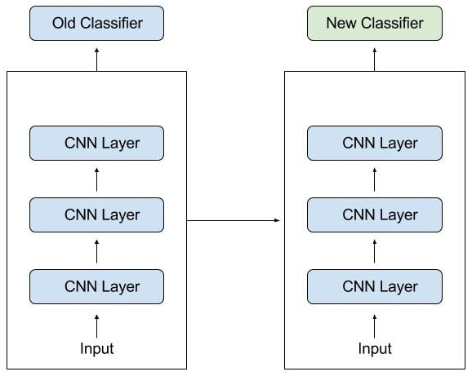
Introduction – Transfer learning
Transfer Learning
Domain Adaptation
https://en.wikipedia.org/wiki/Domain_adaptation
https://www.baeldung.com/cs/transfer-learning-vs-domain-adaptation
Notes:
We use transfer learning to tackle a few of the challenges. Where We reuse of a pre-trained model on a new problem. Tries to exploit what has been learned in one task to improve generalization in another.
But transfer learning is a broad term that describes using the knowledge gained from one machine learning problem in another one.
___________________________________
Domain adaptation describes a special case of transfer learning that only covers the change of the data domain.
apply an algorithm trained in one or more source domains to a different target domain.
the source and target domains all have the same feature space (but different distributions).
in contrast, transfer learning includes cases where the target domain's feature space is different from the source feature space or spaces.

Slide 28
Methodology – Improve this
Dataset/Domain
PEFT
Fine-Tuning
Evaluation
Comparative Analysis
Notes:
We select out dataset

Slide 29
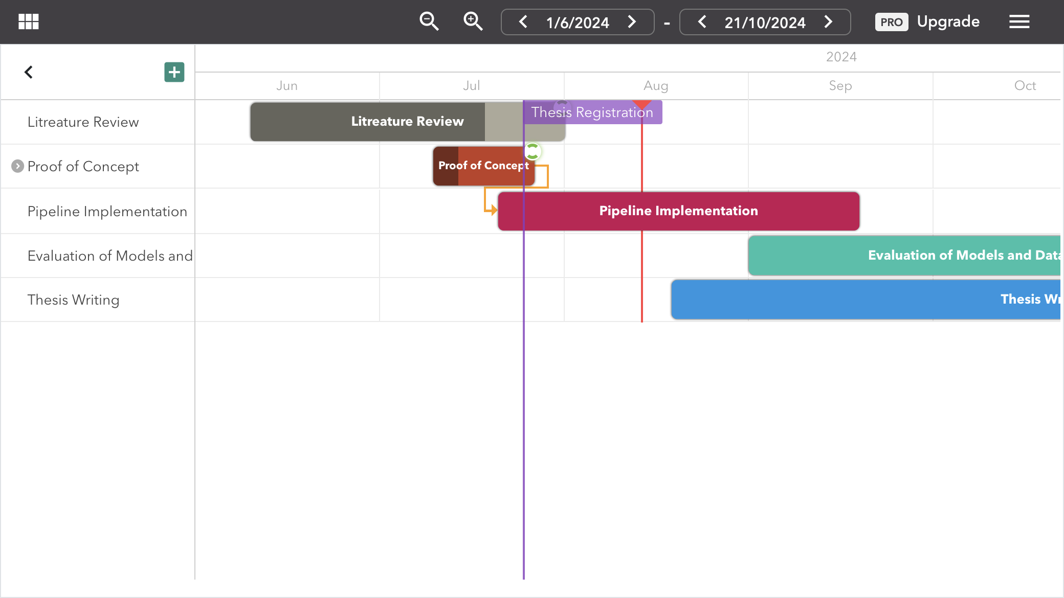
Notes:
Here is the time line for the project.

Slide 30
Introduction – Domain Adaptation
Domain Adaptation - process of customizing general-purpose LLMs
Why is domain adaptation necessary?
Significant differences in language styles
Cater to business models of institutes and organizations
requirement of in-depth knowledge
General-purpose LLMs impossible to be a one-fits-all solver without any customization

Slide 31
Stick to the good sebis traditions
  Provide action links at the bottom of the slide to guide the audience to our web pages or publications (see below). (Select the text, press CTRL-K)
  Use a file name according to our sebis conventions which helps us and our audience to find the file of your presentation on our web site with Google search:
    YYMMDD Author Short Title
    Include this string in the footer (Einfügen -> Kopf- und Fusszeile -> Fusszeile)
    The unusual date format simplifies the search for the latest version of a slide in an alphabetical directory listing (Dropbox, Explorer, Tricia, Sky-Drive)
[Ha13g] Hauder, M., Roth, S., Matthes, F.: Current Tool support for Metrics in Enterprise Architecture Management
For more information visit BEAMS , EAM Pattern Catalog and EAM KPI Catalog (http://wwwmatthes.in.tum.de)

Slide 32
Use the sebis visual language
(shapes, fonts, colors, sizes)
Default
Line Style
Default Rectangle
Default
Rounded R.
Text
Default
Text
User
Store
Information
Arrow
Cloud
Process
Box
Explanation
Fast
Form 1
Fast
Form 2
Fast
Form 3
Fast
Form 4
Fast
Form 5
Fast
Form 6
Fast
Form 6
Fast
Form 1
Fast
Form 2
Fast
Form 3
Fast
Form 4
Fast
Form 5
Fast
Form 6
Fast
Form 6

